Slide 1

Baruch Data Science Challenge 2021
Group 17:
Alexandra Eberts
Elaine Zhang
Eric Sedaghat
Shan Chen

Slide 2

Treatment of Null Values
We first created our main python script
Partitioned data
Dimensionally Reduced
Set up models to run with the PCA and normalized data to compare each
Created three copies of the same script
Drop Nulls
Fill Avg
Fill with 0’s

Slide 3
Data Exploration
Attributes correlation

Slide 4
Data Exploration
charge_cycle_time_below_12 vs dischargecycles

Slide 5
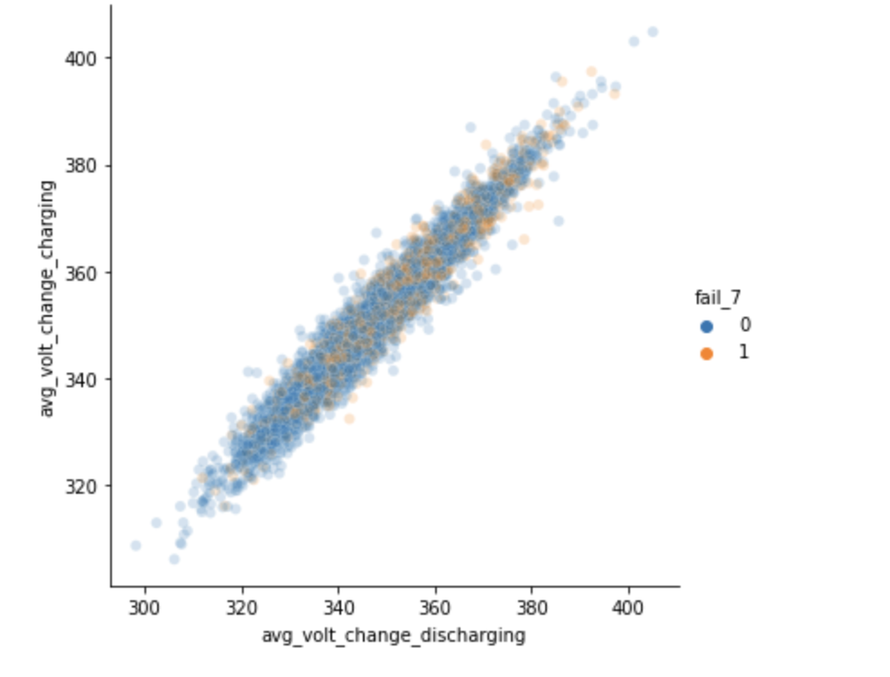
Data Exploration
Avg_Volt_Change_Charging vs Avg_Volt_Change_Discharging

Slide 6
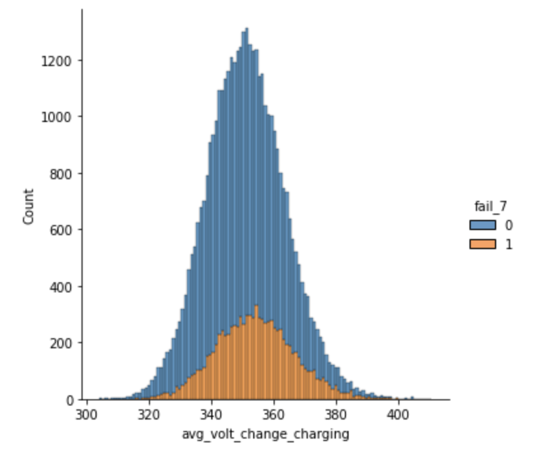
Data Exploration
Stacked Distributions of ‘avg_volt_change_charging’

Slide 7
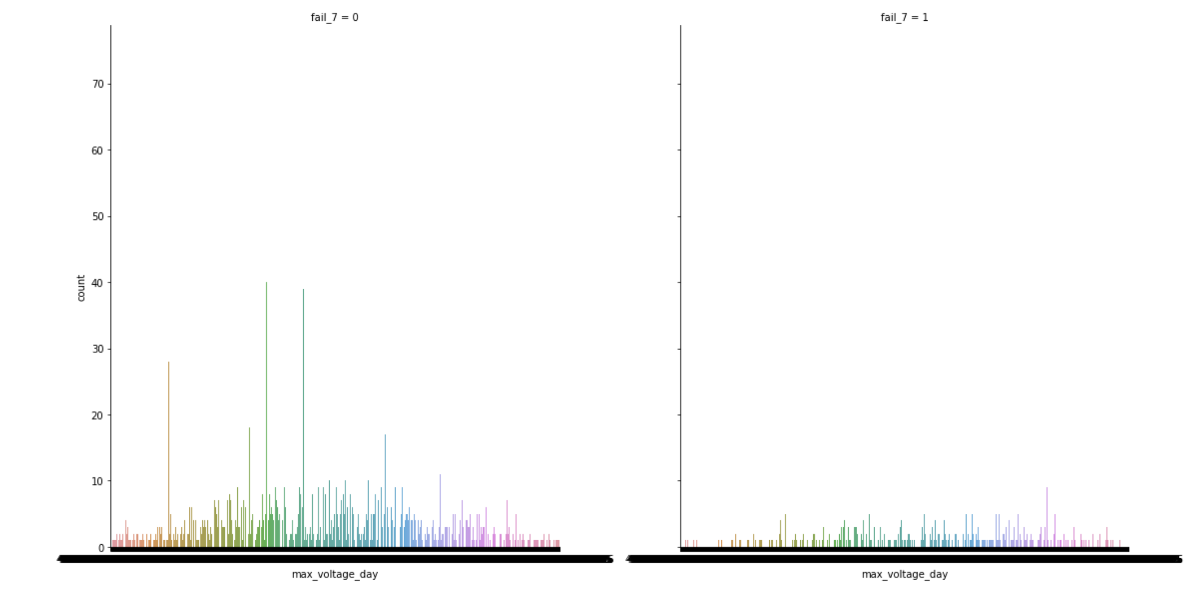
Data Exploration

Slide 8
Data Exploration
Count charge_cycle_time_below_12 for situations in fail_7

Slide 9
Dimensionality Reduction Techniques
Principal Component Analysis
Linear Discriminant Analysis

Slide 10
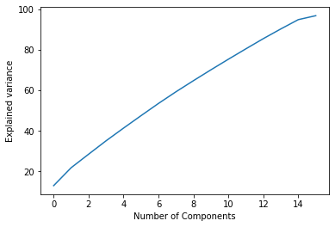
Principal Component Analysis
Specified we wanted 95% of the variance retained
Analysis provided us with 16 components that explained 95% of the variance.

Slide 11
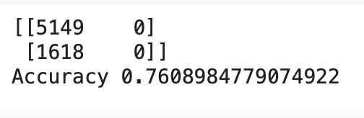
Linear Discriminant Analysis
Ran LDA using one linear discriminant
Gives us ~76% accuracy
Chose to go with PCA for our dimensionality reduction

Slide 12

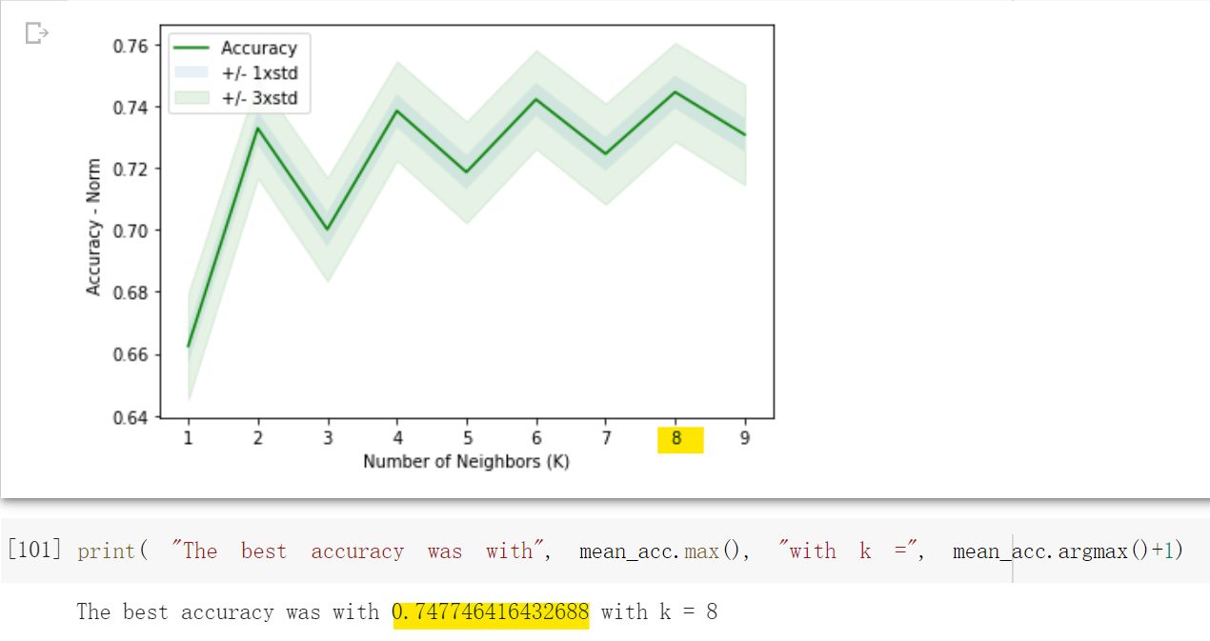
K-Nearest Neighbors fit using Normalized table Values

Slide 13
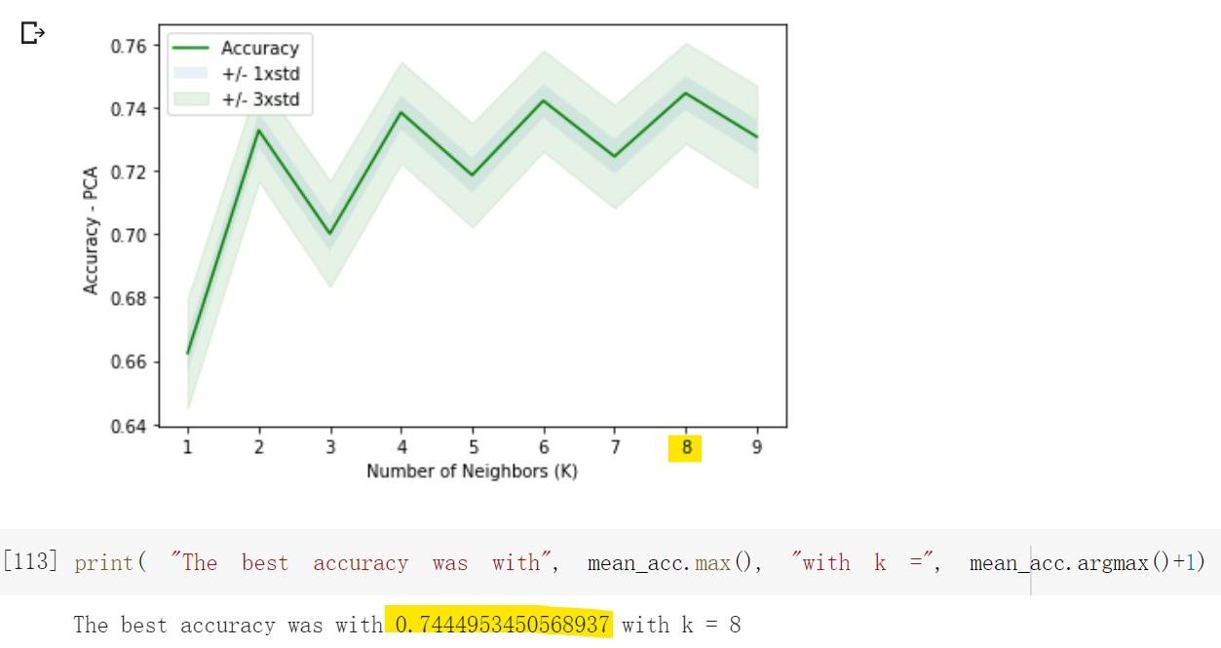
K-Nearest Neighbors fit using PCA

Slide 14
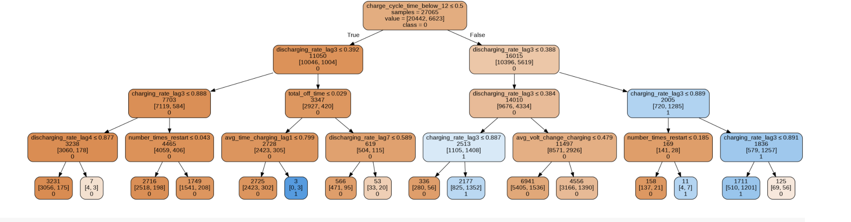
Decision Tree fit using Normalized table Values

Slide 15
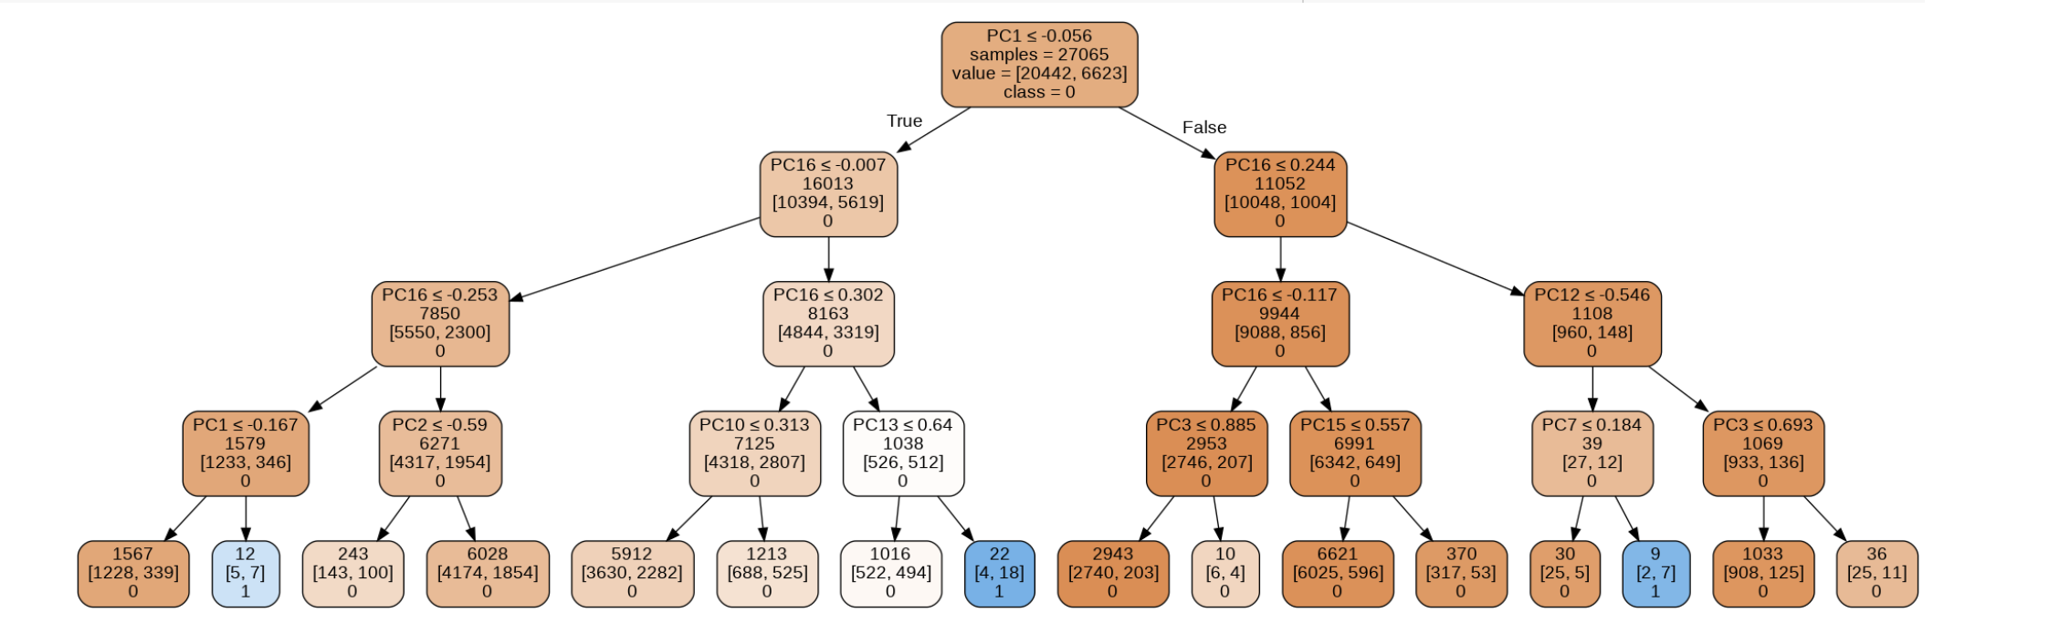
Decision Tree fit using PCA’s

Slide 16
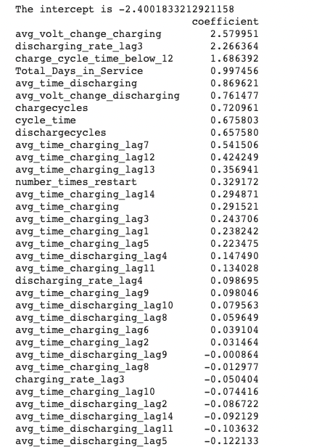
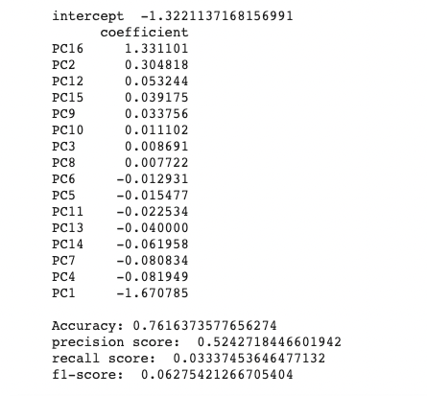
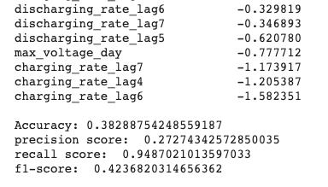
Logistic Regression

Slide 17
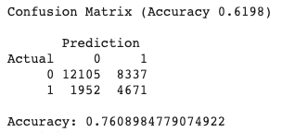
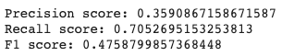
Naïve Bayes using Normalized Values

Slide 18
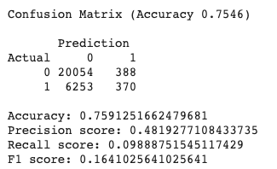
Naïve Bayes using PCA

Slide 19
Summary
Classification problems, looking at accuracy scores of 0.73 – 0.77 in our models
Logistic regression fit with PCA’s had highest accuracy of 0.7616
No other models, except logistic regression using the normalized set, were disqualified based on this measure
Checked the F1 scores, Naïve Bayes model fit with PCA’s returned strong precision and recall scores compared to other models
Naïve Bayes with normalized data also returned strong precision and recall scores when compared to other models
Therefore, we chose the Naïve Bayes model fit with PCA’s data for our model

